Slide 1
BritishAirline
Reviews Analysis

Slide 2
What the percentage of negative reviews?
70% Negative
30% Positive
10% Neural

Slide 3
Which seat type has the highest negative reviewed
50% for Economy class
25% for Business class
2% for Premium class
2% for First class

Slide 4
Which Route was rated negative the most
Istanbul to Manchester
Istanbul to Toronto
Detroit to Skopje via Istanbul
Istanbul to New York

Slide 5
Sentiment Distribution by Type of Traveller
Negative
Positive
Family- 95%
Couple- 75%
Business- 40%
Solo- 80%
Family- 45%
Couple- 43%
Business- 50%
Solo- 50%

Slide 6
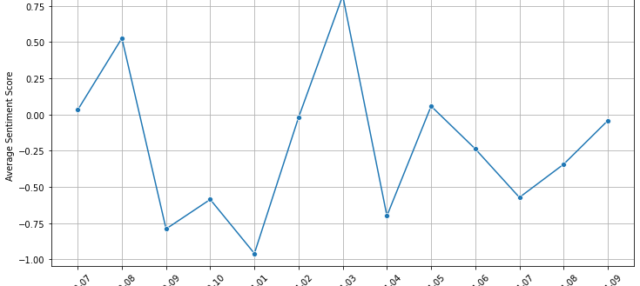
Sentiment Trend Over Time
January to April 2024 has the highest negative review.

